Slide 1
Supermarket sales Analysis

Slide 2
Introduction :
Welcome to our presentation on Supermarket Sales Analysis In this session we will delve into the intricate details of sales data to uncover patterns trends and insights that can drive business decisions and strategies.

Slide 3
Key Objectives of the Analysis :
Identify Trends: Understand the patterns in sales over time to forecast future performance.
Enhance Customer Satisfaction: Analyze customer behavior to improve service and product offerings.
Optimize Inventory: Ensure the right products are available at the right time to minimize stockouts and overstock situations.
Increase Revenue: Identify opportunities to boost sales through targeted promotions and marketing strategies.
Improve Operational Efficiency: Streamline processes to reduce costs and improve profitability.

Slide 4
An overview of the supermarket and its importance in our daily lives:-
1. Convenience
One-Stop Shopping : Supermarkets offer a diverse range of products, including groceries, household items, personal care products, and more, all under one roof.
2. Quality and Safety :
Food Safety Standards: Supermarkets adhere to strict food safety and hygiene standards to ensure the products they sell are safe for consumption.

Slide 5
An overview of the supermarket and its importance in our daily lives:-
Supermarkets are a vital component of modern life, contributing significantly to convenience affordability and community well-being. Their role extends beyond mere retail impacting local economies fostering community spirit and embracing technological advancements to better serve their customers Understanding the importance of supermarkets helps us appreciate their contribution to our daily lives and the broader economic landscape.

Slide 6
An Overview Of Our Data :
1. Basic Information
Invoice ID: Unique identifier for each transaction.
Branch: Store branch where the transaction took place (A, B, C).
City: Location of the store (Yangon, Naypyitaw, Mandalay).
Customer Type: Type of customer (Member, Normal).
Gender: Gender of the customer (Male, Female).

Slide 7
An Overview Of Our Data :
2. Product Information
Product Line: Category of products purchased (e.g., Health and beauty, Electronic accessories).
Unit Price: Price per unit of the product.
Quantity: Number of units purchased.
3. Financial Details
Tax 5%: Tax amount for the transaction.
Total: Total amount paid including tax.
Gross Margin Percentage: Percentage of gross margin.
Gross Income: Income before tax.

Slide 8
An Overview Of Our Data :
4. Customer Feedback
Rating: Customer rating of the transaction.
5. Date and Time Information
Day: Day of the month when the transaction occurred.
Month: Month of the year when the transaction occurred.
Day Name: Day of the week.
Month Name: Name of the month.
Year: Year of the transaction.
Hour: Hour of the day when the transaction occurred.
Day Period: Part of the day (Morning, Afternoon, Evening).

Slide 9
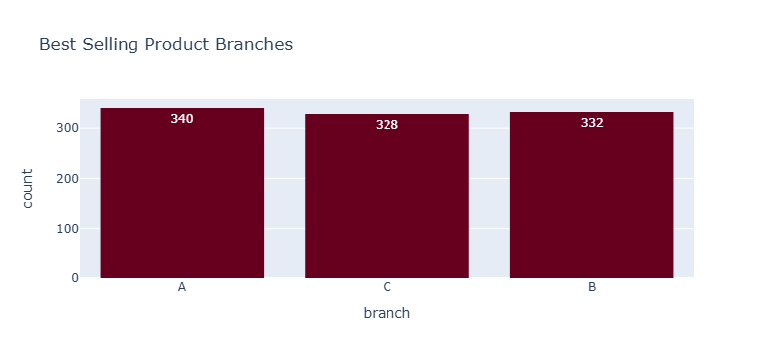
View Analytics :-
Each bar's height corresponds to the number of best-selling products in the respective branch :
Branch A has the highest count with 340 best-selling products.
Branch C has 328 best-selling products.
Branch B has 332 best-selling products

Slide 10
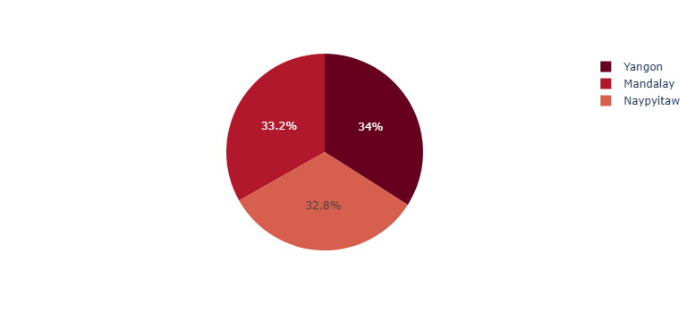
The pie chart is divided into three segments each representing a city.
The percentages within each segment show the proportion of the total that each city represents.
Yangon: 34%
Mandalay: 33.2%
Naypyitaw: 32.8%
Yangon has a slight lead at 34%

Slide 11
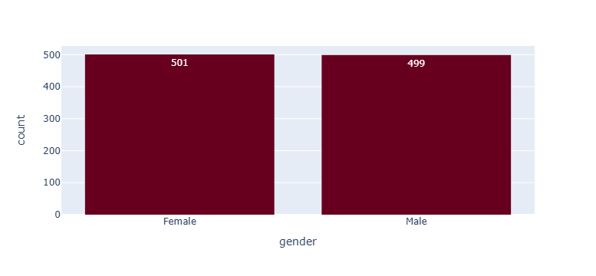
Which gender is the highest in purchasing or requesting orders?
It was found that females are the highest in demand for orders, with a percentage of 501

Slide 12
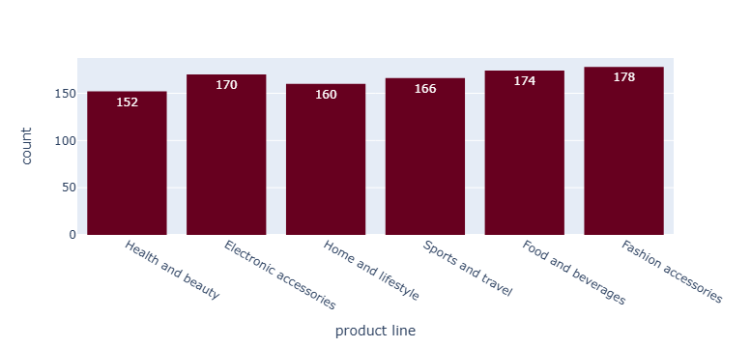
We have 6 types of production lines in our data with the highest production being (Fashion accessories 178). The least productive was (Home and lifestyle 160).

Slide 13
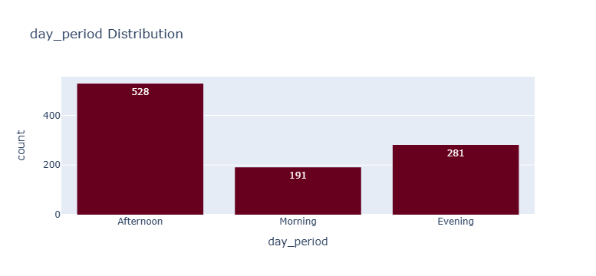
The best period for selling products was in the afternoon

Slide 14
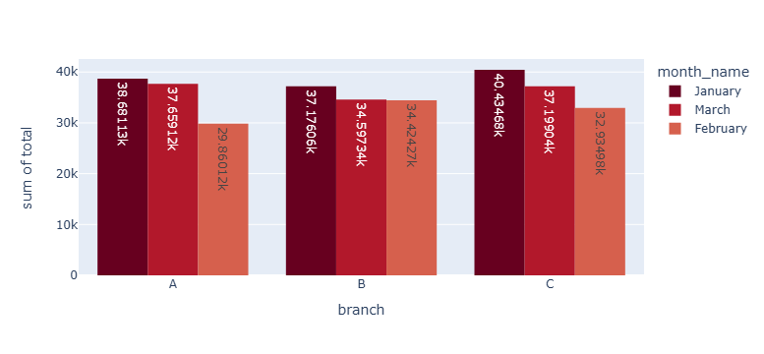
MulitVariate Plots
Total profit for each branch

Slide 15
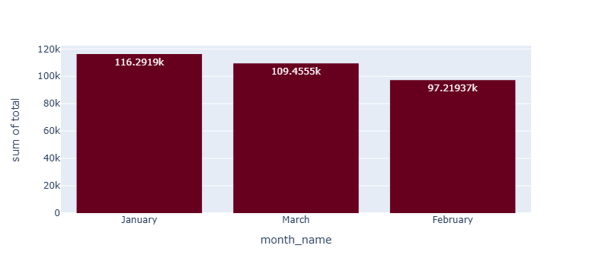
In which month most of the sales occur?¶
From January, supermarket sales have slightly decreased.
February receives least sales.
This can be because February is the shortest month.
Month-wise change in sales not very significant.

Slide 16
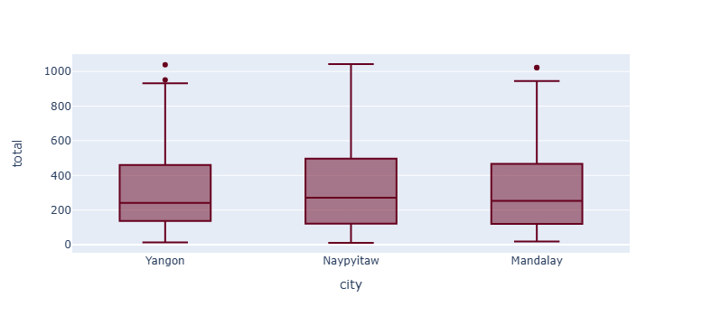
city that recorded values ​​unexpected from the real values

Slide 17
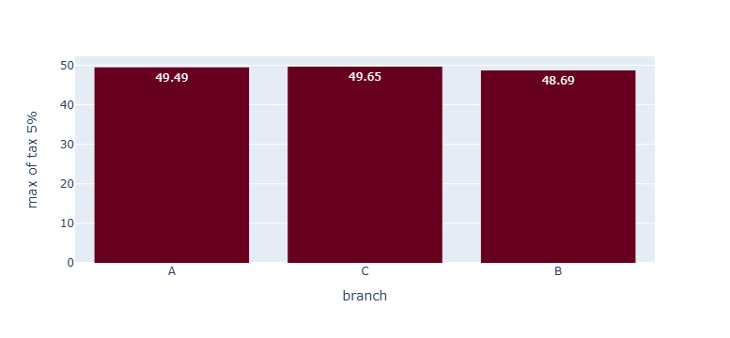
The branches that pay the highest tax:

Slide 18
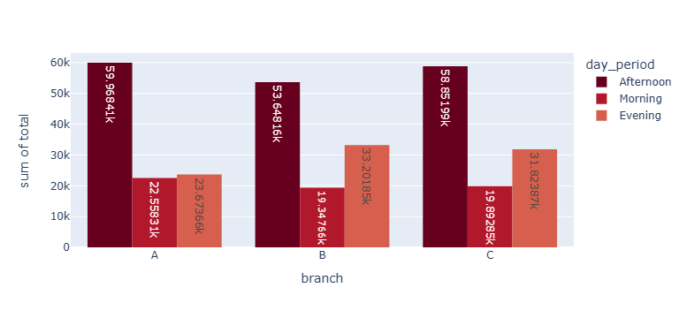
The highest profitable period today in all our branches was in the afternoon

Slide 19
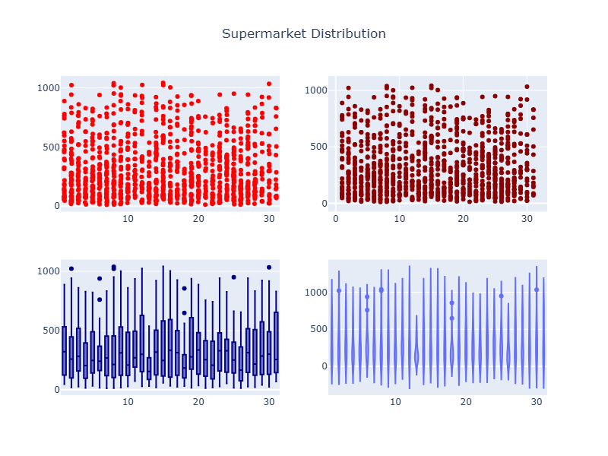
Days that recorded values ​​unexpected from the real values

Slide 20
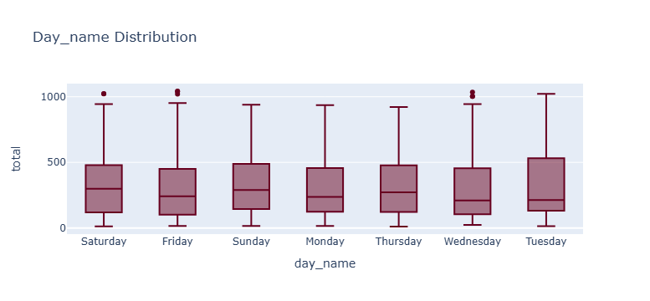
Days that recorded values ​​unexpected from the real values

Slide 21
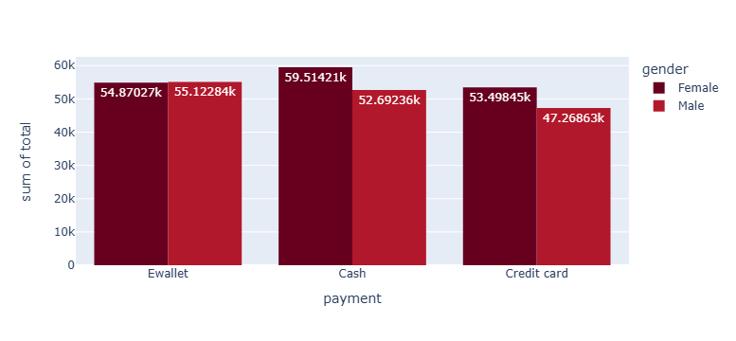
Find out the total profit of both genders by payment

Slide 22
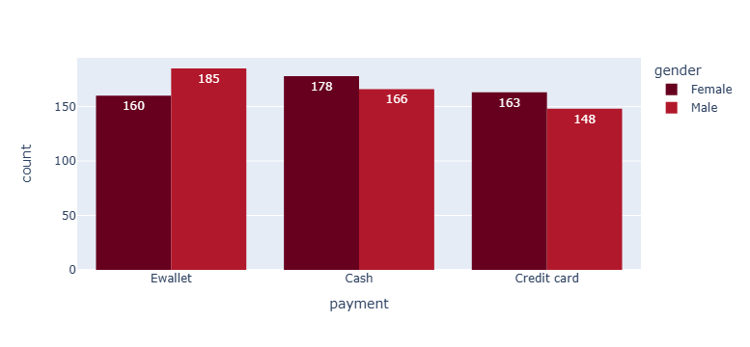
What is the best way to pay for both genders?

Slide 23
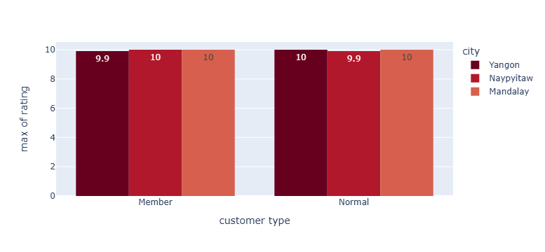
Knowing the ratings for customer type :-

Slide 24
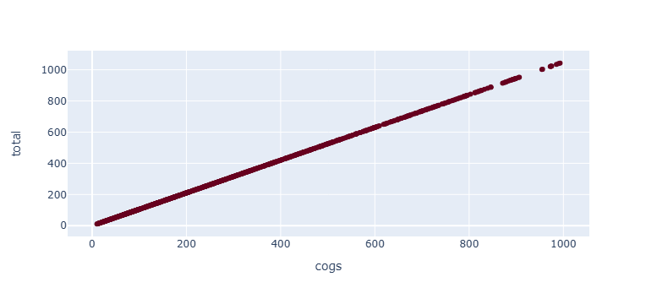
Relationship between the 5% tax and the total

Slide 25
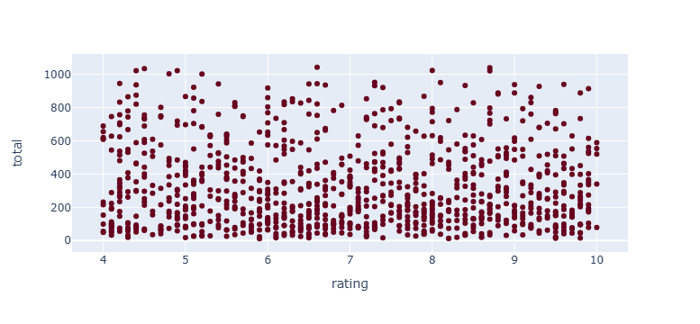
The order's rating range in terms of total

Slide 26
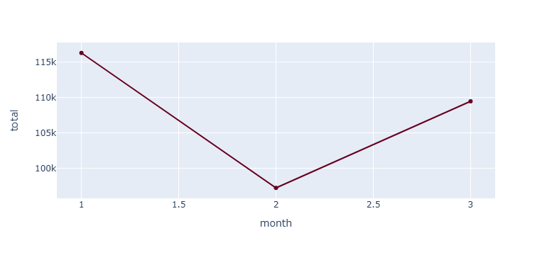
In which month did we reach the maximum level in profits and in which month did it fall?

